Slide 1
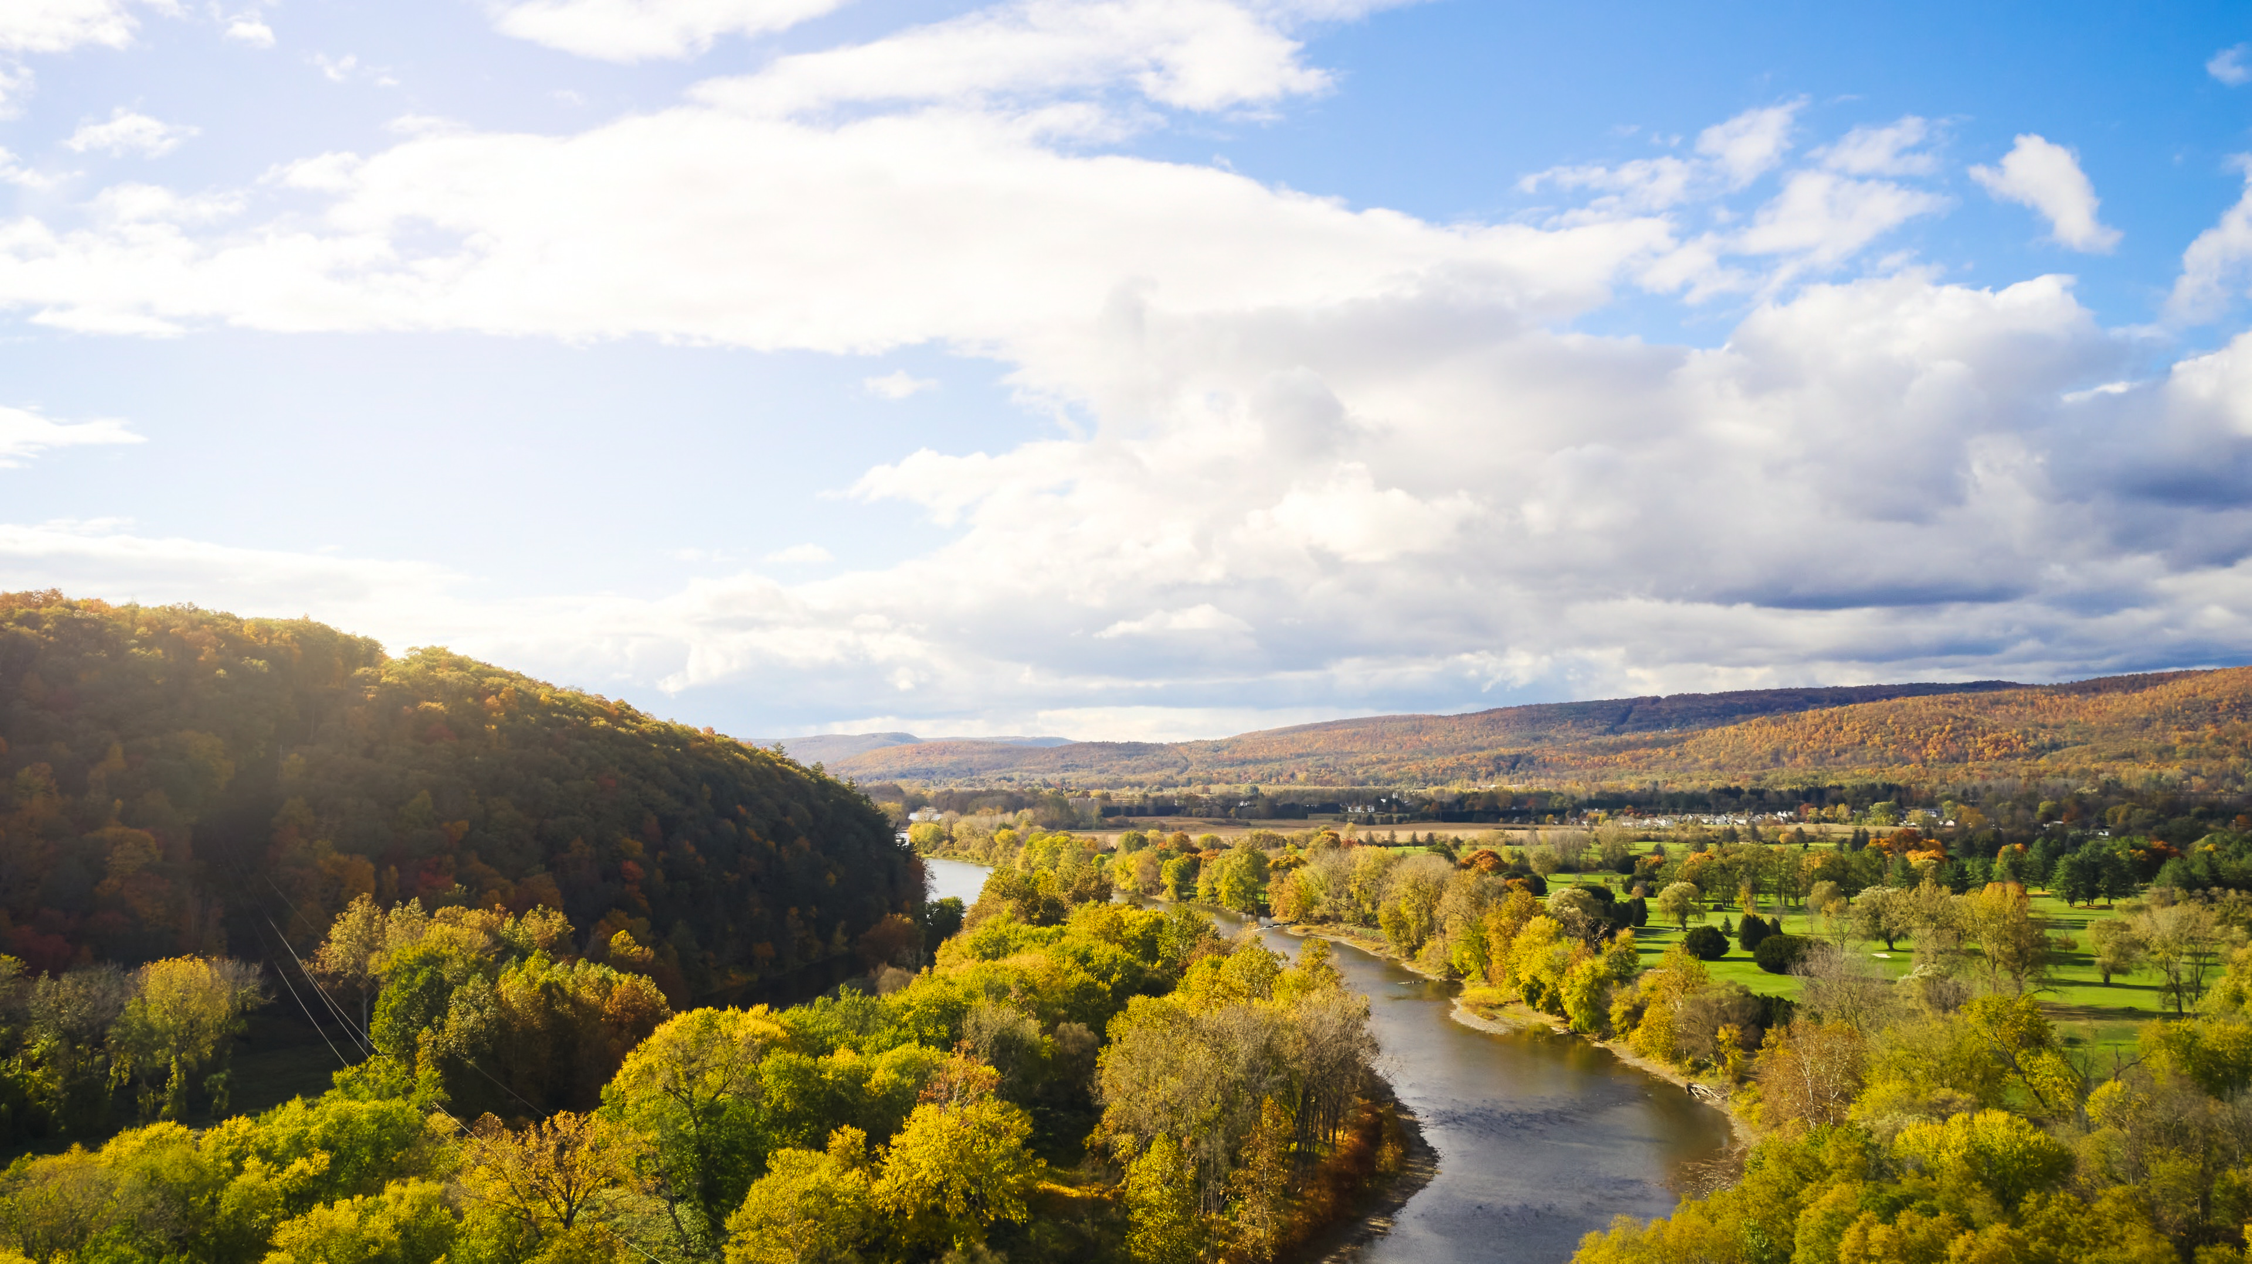

Public Workshop #2
September 17, 2024

Slide 2

Agenda
Welcome and Introductions
Project Overview Presentation
Small Group Goal Setting Workshop
Wrap Up & Next Steps

Slide 3







REVIEW FROM LAST MEETING: PROJECT TEAM
Chemung County Partners
Consultant Team

Slide 4


REVIEW FROM LAST MEETING Three Planning Efforts
Comprehensive Plan
Long Range Transportation Plan
Agricultural and Farmland Protection Plan

Slide 5
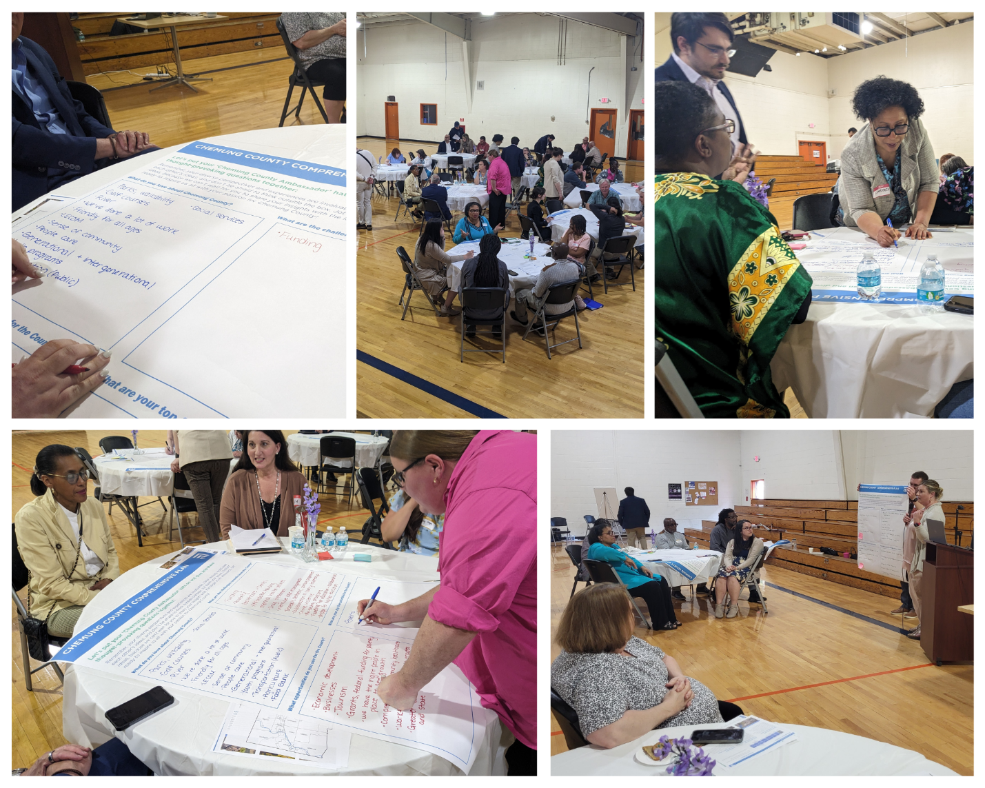
Review from Last Meeting: Meeting Highlights Public Meeting #1 (May 30)
Overview
In person and Zoom attendance
Presentation followed by group discussions
Group Discussion Summary
Love: nature, culture, community, diversity, cost of living, health facilities
Challenges: poverty, job market, crime, infrastructure, aging population, barriers to services
Opportunities & priorities: economic development, ecotourism, public transportation, redevelopment of brownfields, retaining youth, alleviation poverty, agriculture
Full meeting summary is available on County website.

Slide 6
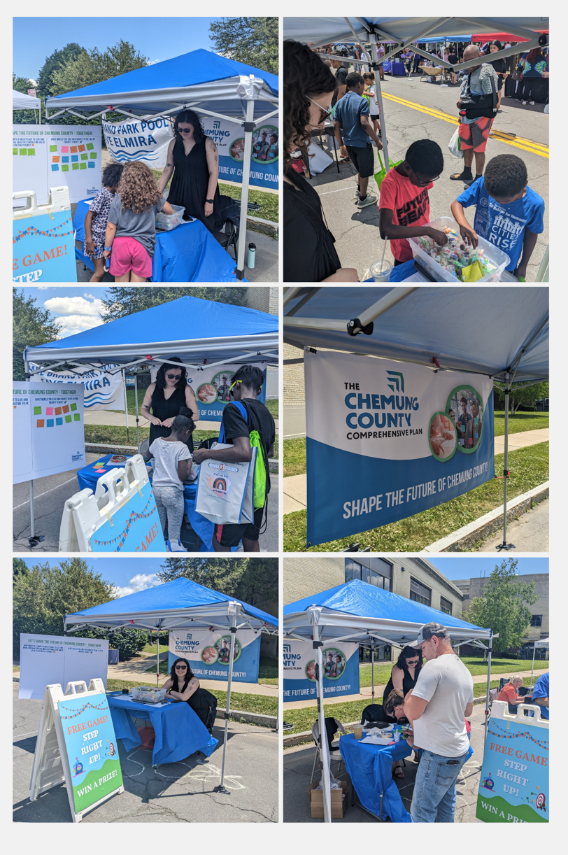
Public Outreach Updates Pop-Up: Juneteenth (June 15)
Overview
Free “Ring Toss” game with prized to attract visitors
Discussions with attendees about the three planning efforts
Advertised surveys and project websites (including QR codes to website)
Over 90 visitors
Group Discussion Summary
Love: cultural resources, community, and opportunities for personal impact
Focus on the Future: education, environment, economic development, housing, arts, social services

Slide 7
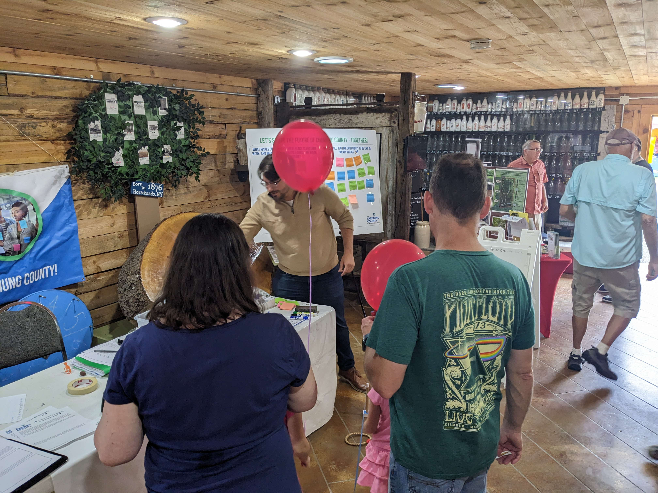
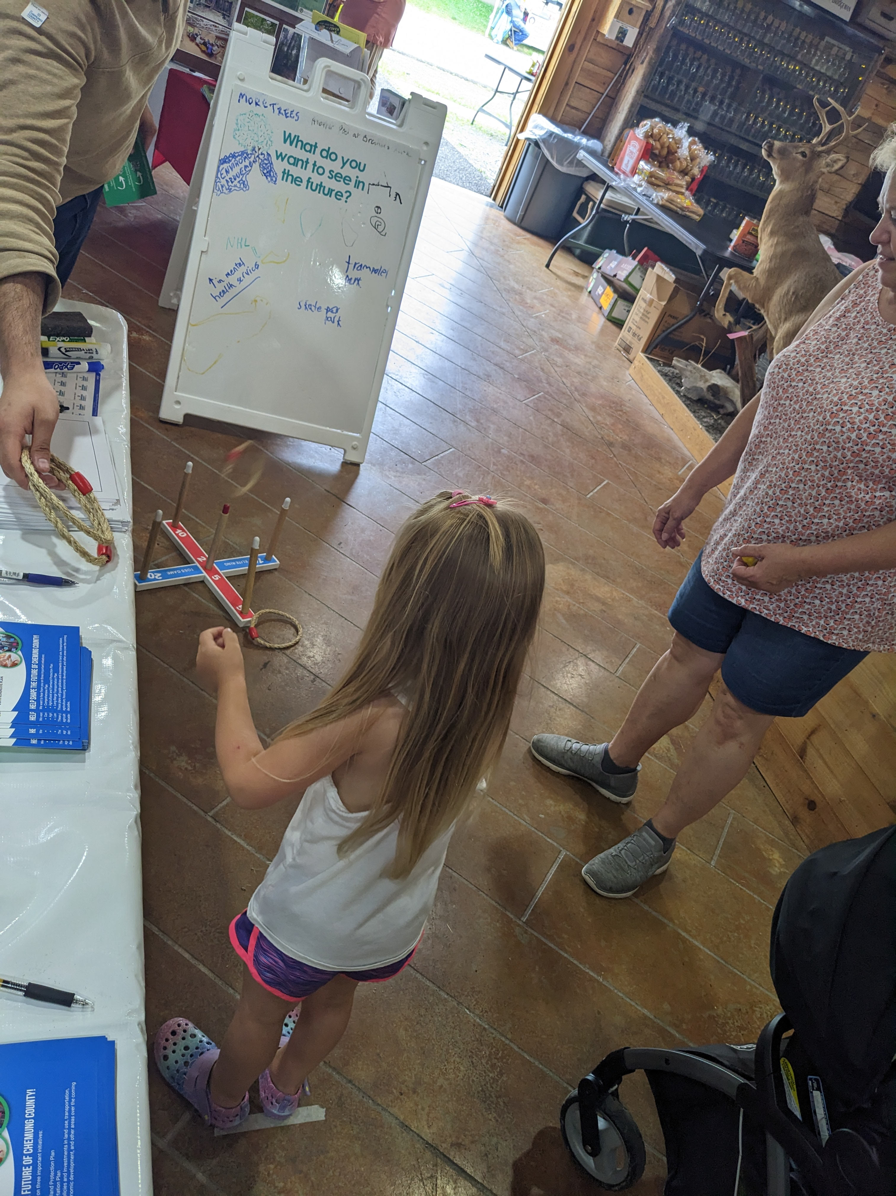
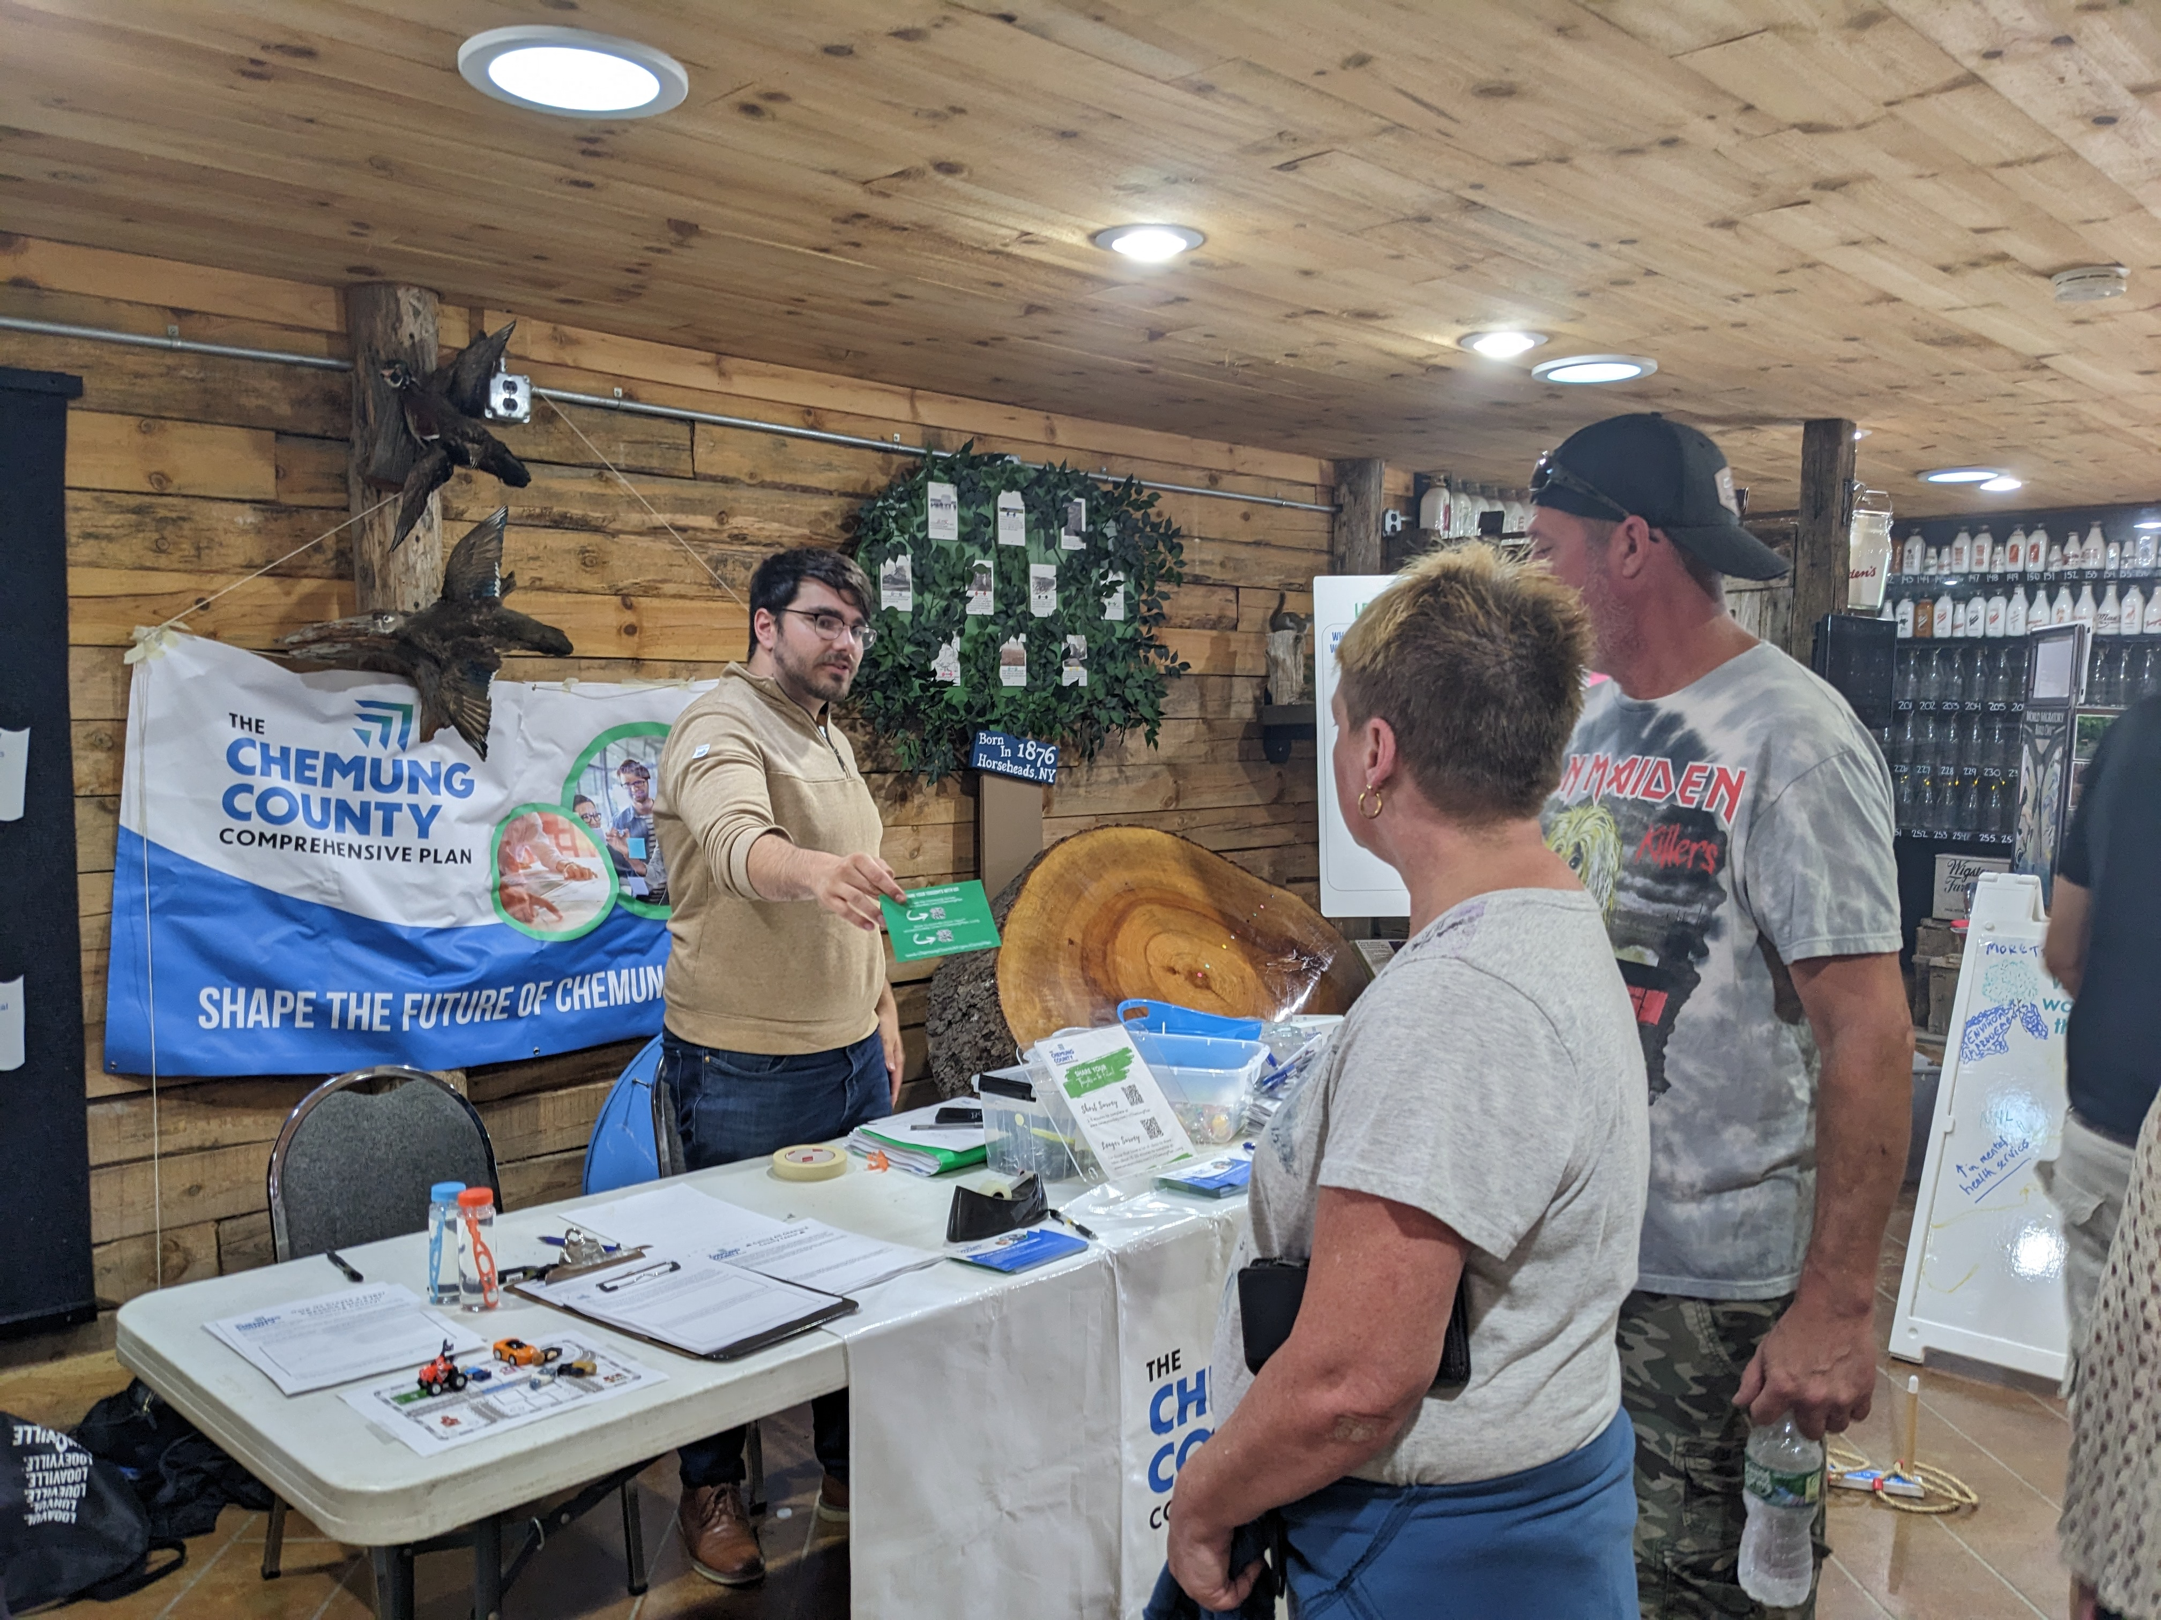
Public Outreach Updates County Fair Pop-Up (August 3)
Overview
Free “Ring Toss” game with prized to attract visitors
Discussions with attendees about the three planning efforts
Advertised surveys and project websites
Over 70 visitors
Group Discussion Summary
Love: Natural resources, community, affordability
Focus on the Future: Agricultural protection, attractions for all ages, connection to natural environment, social services

Slide 8
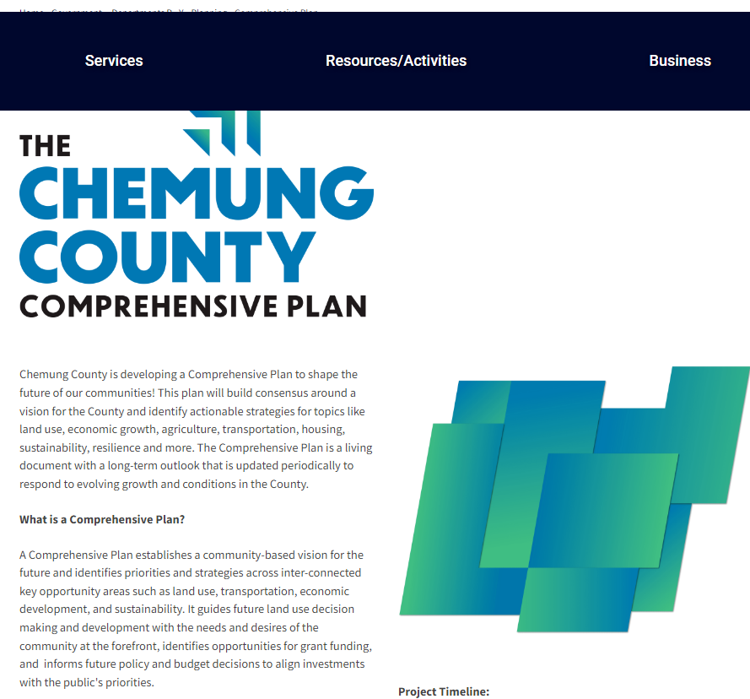
Public Outreach Updates Surveys
https://www.chemungcountyny.gov/CompPlan
4 public surveys
Long community survey
Short community survey
Youth survey
Teenager survey
Please take our survey if you haven’t already! Surveys are available on the Chemung County Comprehensive Plan webpage!

Slide 9
Public Outreach Summary What We’ve Heard From You
Highland to complete this slide

Slide 10

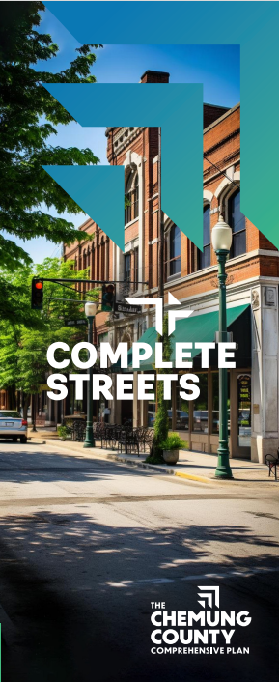


Educational Materials Brochures (Check County website!)

Slide 11
Schedule
Review Existing Planning Documents; Branding and Outreach Strategy
Inventory and Analysis; Public Meeting #1
Public Outreach, Educational Materials, Goal Setting; Public Meeting #2
Implementation Strategies and Recommendations; Draft Plans; Public Meeting #3
Final Plans; SEQR Review; Public Meeting #4
Municipal/Agency Adoption

Slide 12
Next Steps: Implementation + Recommendations
Inventory
13 technical memorandums
Wrap into final Comprehensive Plan
Inform Agricultural and Farmland Protection Plan, and Long-Range Transportation Plan
Public Outreach
Public Meetings / Workshops
Focus Groups
Surveys
Project Webpage
Pop-Ups
Implementation
Informed by Inventory and Public Outreach
Short, Medium, and Long Term projects, programs, and initiatives
Implementation matrix
Conceptual graphics and illustrations
Begin developing a series of goals and objectives for the Comprehensive Plan based on inventory, public feedback, and stakeholder engagement

Slide 13
Group Discussion
Arts and Culture
Historic Resources
Outdoor Recreation
Youth and Senior Services
Workforce Development
Transportation Services
Tourism
Natural Resources Protection
Agriculture and Farmland
What are some goals and objectives you want to see reflected in the Comprehensive Plan’s recommendations?
For example…
Improved transit between cultural institutions
Additional funding for senior services
Prioritize protection for historic and natural resources

Slide 14
Key Contact Information
County Contact
Consultant Team
Chemung County Planning Department
Email: planning@chemungcountyny.gov
Phone: (607) 737-5510
Frank Armento, AICP
Fisher Associates
Planning Studio Manager
Email: farmento@fisherassoc.com
Phone: (716) 858-1234 ext. 306
Sarah Martin, AICP
Fisher Associates
Planner II
Email: smartin@fisherassoc.com
Phone: (585) 334-1310 ext. 208
Tyler Kuty
Fisher Associates
Planner I
Email: tkuty@fisherassoc.com
Phone: (716) 858-1234 ext. 321

